Slide 1
Mennonite Mission Network requests prayer for the Nigeria Mennonite Church and the Nigeria Anabaptist Peace Center, as they work for peaceful communities in their multi-cultural context, where Muslim-Christian relations are often challenging.
^{January 5, 2025}

Slide 2
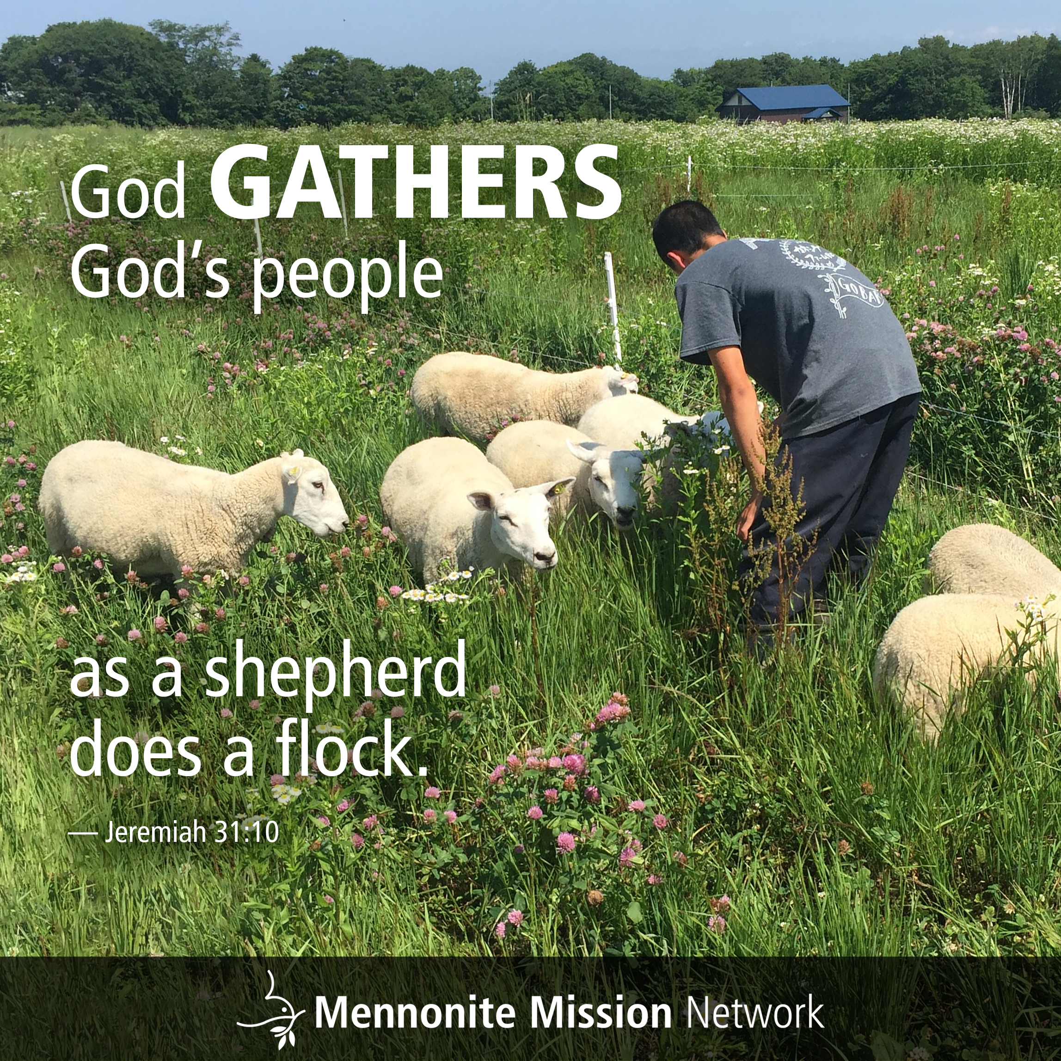

Slide 3
Mennonite Mission Network praises God for the 29 SOOP volunteers serving in Arizona and Florida this month. Pray that these SOOPers will be a blessing to vulnerable populations, as they serve between two weeks and four months.
^{January 12 , 2025}

Slide 4


Slide 5
Mennonite Mission Network requests prayer for the South American celebration of Anabaptism at 500, taking place in Cusco, Peru. Pray that during these five days of worship, learning and fellowship, Anabaptists will experience renewed inspiration to carry their rich spiritual legacy into current contexts.
^{January 19, 2025}

Slide 6


Slide 7
Mennonite Mission Network requests prayer for the ministry of the Korea Anabaptist Center, in Chuncheon, South Korea. Pray for the staff members as they share Anabaptist-Mennonite resources with those interested in learning about peace theology and restorative justice.
^{January 26, 2025}

Slide 8


